Slide 1
Different CNN Architectures
Sourav Karmakar
souravkarmakar29@gmail.com

Slide 2
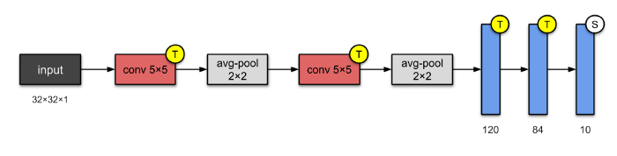
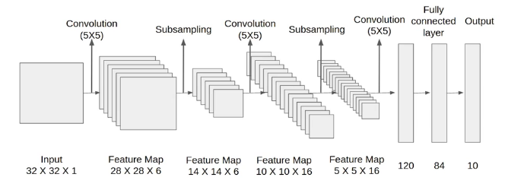
LeNet-5 (1998)
LeNet-5 is one of the simplest architectures. It has 2 convolutional and 3 fully-connected layers (hence “5” — it is very common for the names of neural networks to be derived from the number of convolutional and fully connected layers that they have). The average-pooling layer as we know it now was called a sub-sampling layer and it had trainable weights (which isn’t the current practice of designing CNNs nowadays).
Very efficient in recognizing handwritten digits.

Slide 3

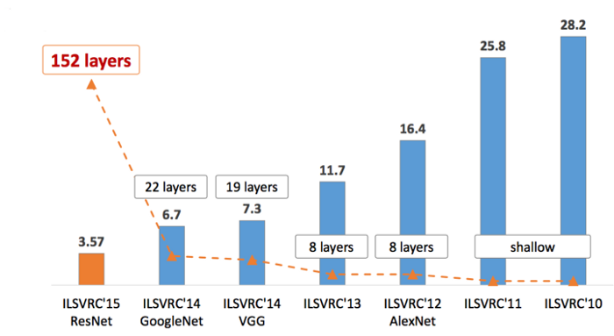
Challenge
ImageNet Large Scale Visual Recognition Challenge (ILSVRC) was an annual computer vision competition developed upon a subset of a publicly available computer vision dataset called ImageNet. As such, the tasks and even the challenge itself is often referred to as the ImageNet Competition.
The ImageNet competitions were hosted from 2010 to 2016 and very interesting and useful CNN architectures were developed by industry and academia for this competition. Those architectures are still widely used.

Slide 4
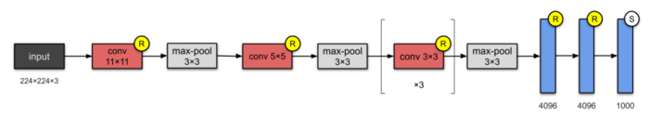
AlexNet (2012)
With 60M parameters, AlexNet has 8 layers — 5 convolutional and 3 fully connected. AlexNet just stacked a few more layers onto LeNet-5. At the point of publication, the authors pointed out that their architecture was “one of the largest convolutional neural networks to date on the subsets of ImageNet.”
They were the first to implement Rectified Linear Units (ReLUs) as activation functions.
They also implemented Dropout for handling overfitting in large Neural Networks.
Winner of ILSVRC – 2012.

Slide 5
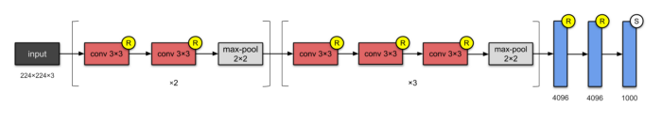
VGG-16 (2014)
This was developed at Visual Geometry Group (VGG) of Oxford University. VGG-16 has 13 convolutional and 3 fully-connected layers, carrying with them the ReLU tradition from AlexNet.
It consists of 138M parameters and takes about 500MB storage Space.
It is used as backbone architecture for feature extraction for various Computer Vision related tasks.

Slide 6
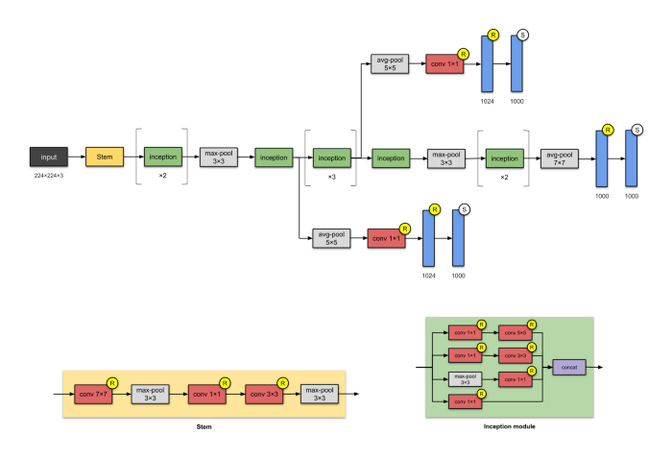
Inception-v1 (2014)

Slide 7
Inception-v1 (2014)
This 22-layer architecture with 5M parameters is called the Inception-v1. Here, the Network In Network approach is heavily used, as mentioned in the paper. The Network In Network is implemented via Inception modules. Each module presents 3 ideas:
Having parallel towers of convolutions with different filters, followed by concatenation, captures different features at 1×1, 3×3 and 5×5, thereby ‘concatinating’ them.
1×1 convolutions are used for dimensionality reduction to remove computational bottlenecks.
Due to the activation function from 1×1 convolution, its addition also adds nonlinearity.

Slide 8









Slide 9













Slide 10













Slide 11




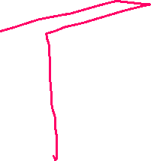









Slide 12

















Slide 13

















Slide 14


















Slide 15








